Slide 1


Machine Learning
Electrical Summer Workshops (ESW) 2022
Electrical Engineering Department - Sharif University of Technology
Instructors: Alireza Gargoori Motlagh – Mohammad Mahdi Mirrashid – Ali Nourian

Slide 2
TREE-BASED METHODS

Slide 3
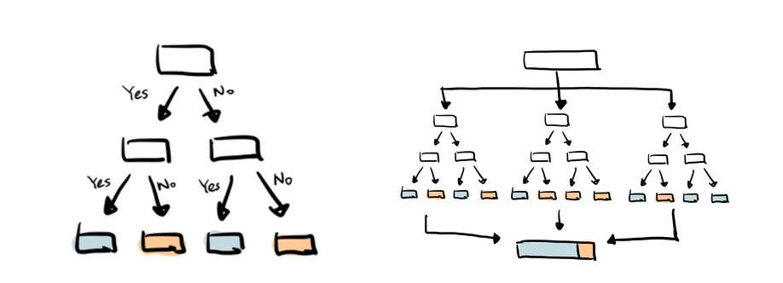
Tree-Based Methods
Figure 1. Classification with tree-based methods

Slide 4
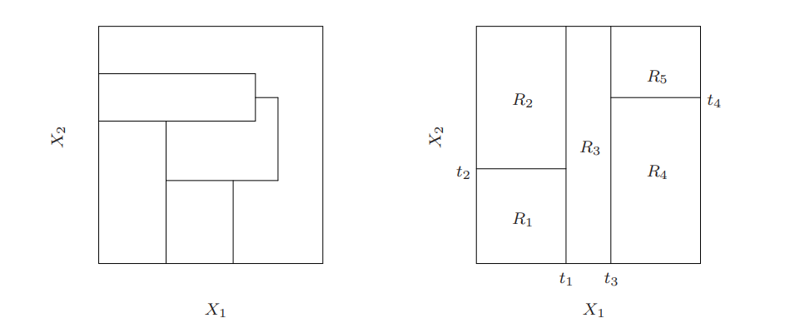
Tree-Based Methods
Tree-based methods partition the feature space into a set of rectangles
Fit a simple model (like a constant) to each region
The region might be hard to describe
Two approaches to partitioning: Regular splitting vs. Recursive binary splitting
Figure 2. Regular splitting vs. Recursive binary splitting

Slide 5
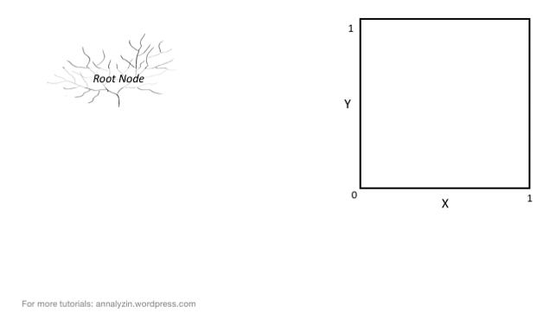
Tree-Based Methods

Slide 6
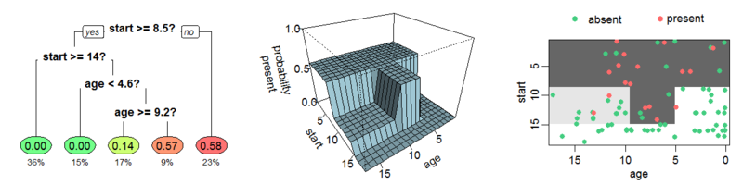
Regression Trees
At each step, each variable is considered to find the best splitting point (resulting in the least RSS)
The mean of the data is fit to each region
The splitting process is repeated on each of the regions until a stopping rule applies
Figure 3. Three different ways of showing the same regression tree

Slide 7
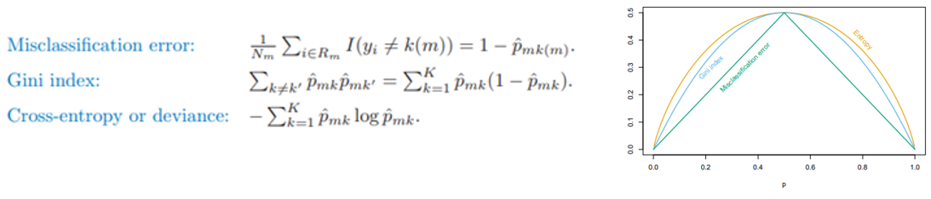
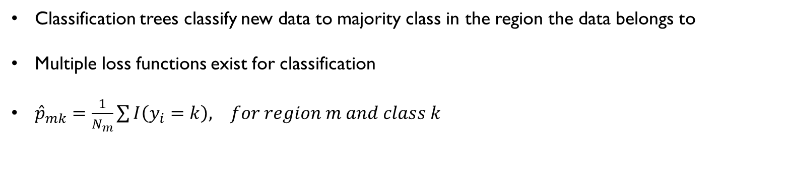
Classification Trees
Classification trees classify new data to majority class in the region the data belongs to
Multiple loss functions exist for classification
${\hat{p}}_{mk}=\frac{1}{N_{m}}\sum{I\left(y_{i}=k\right), for region m and class k}$
Figure 4. Different measures of node “impurity”

Slide 8
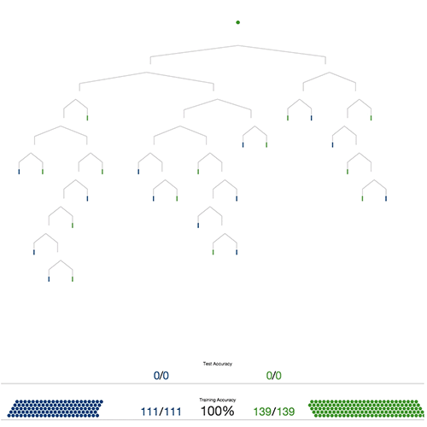
Classification Trees

Slide 9
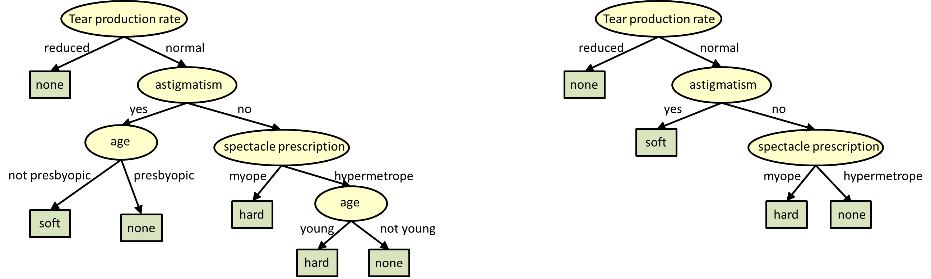
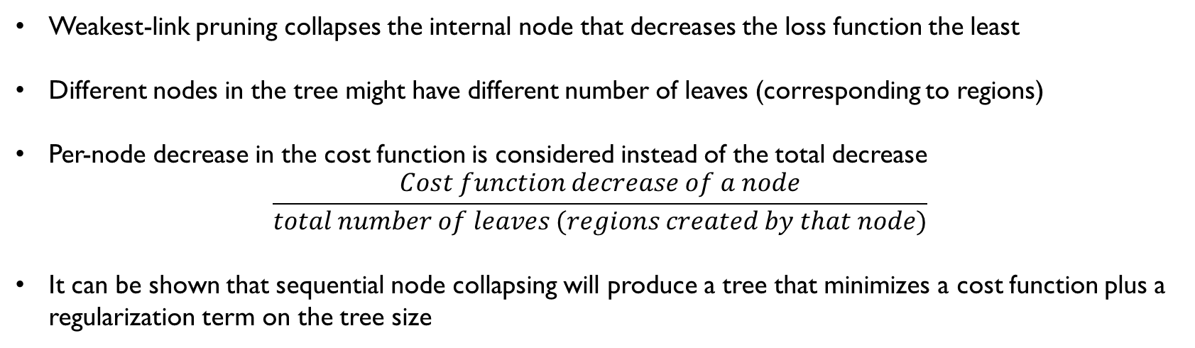
Tree-Pruning
Weakest-link pruning collapses the internal node that decreases the loss function the least
Different nodes in the tree might have different number of leaves (corresponding to regions)
Per-node decrease in the cost function is considered instead of the total decrease
$$\frac{Cost function decrease of a node}{total number of leaves (regions created by that node)}$$
It can be shown that sequential node collapsing will produce a tree that minimizes a cost function plus a regularization term on the tree size
Figure 5. Tree before and after pruning

Slide 10
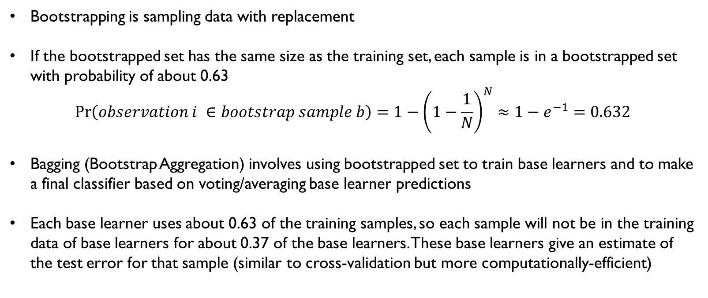
Bootstrapping and Bagging
Bootstrapping is sampling data with replacement
If the bootstrapped set has the same size as the training set, each sample is in a bootstrapped set with probability of about 0.63
$$\operatorname{Pr}\left(observation i ∈bootstrap sample b\right)=1−{\left(1−\frac{1}{N}\right)}^{N}≈1−e^{−1}=0.632$$
Bagging (Bootstrap Aggregation) involves using bootstrapped set to train base learners and to make a final classifier based on voting/averaging base learner predictions
Each base learner uses about 0.63 of the training samples, so each sample will not be in the training data of base learners for about 0.37 of the base learners. These base learners give an estimate of the test error for that sample (similar to cross-validation but more computationally-efficient)

Slide 11
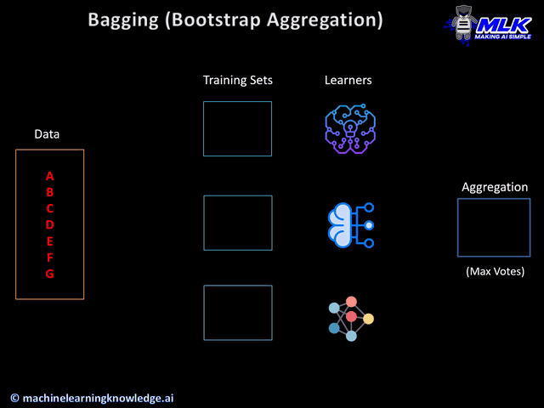
Bagging (Bootstrap Aggregation)

Slide 12
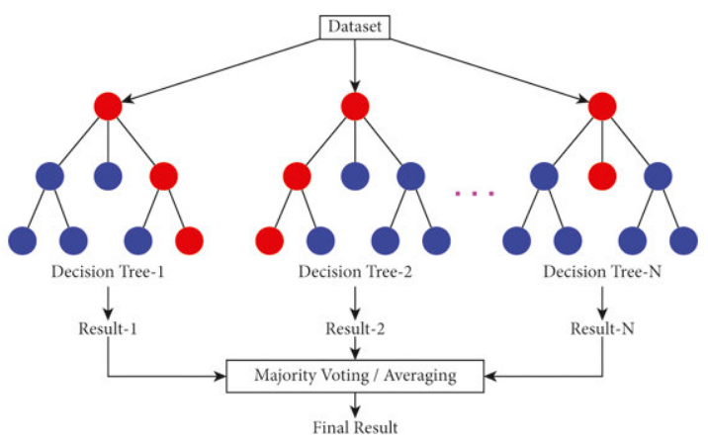
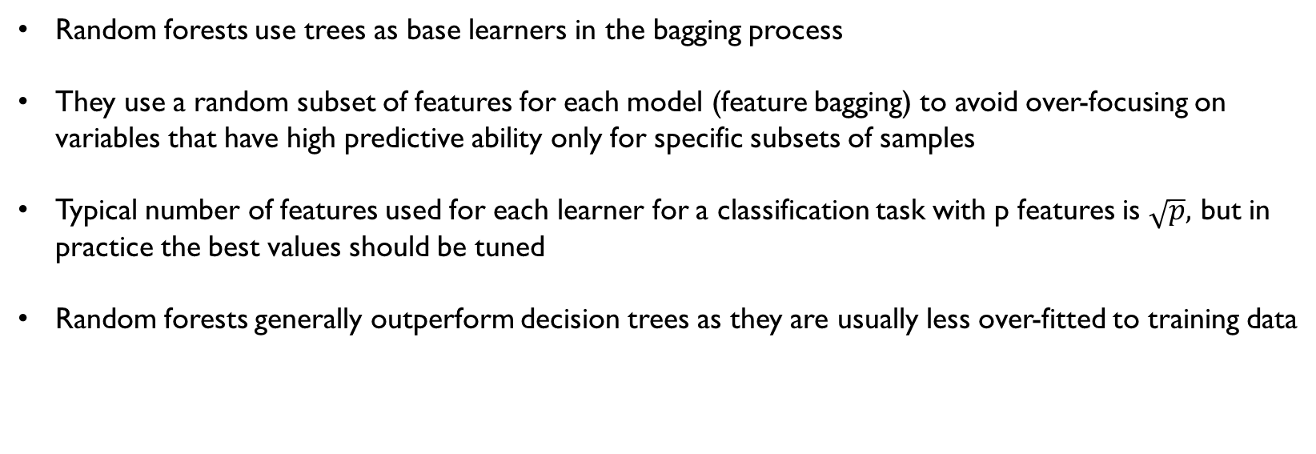
Random Forests
Random forests use trees as base learners in the bagging process
They use a random subset of features for each model (feature bagging) to avoid over-focusing on variables that have high predictive ability only for specific subsets of samples
Typical number of features used for each learner for a classification task with p features is $\sqrt{p},$ but in practice the best values should be tuned
Random forests generally outperform decision trees as they are usually less over-fitted to training data
Figure 6. A general random forest model

Slide 13
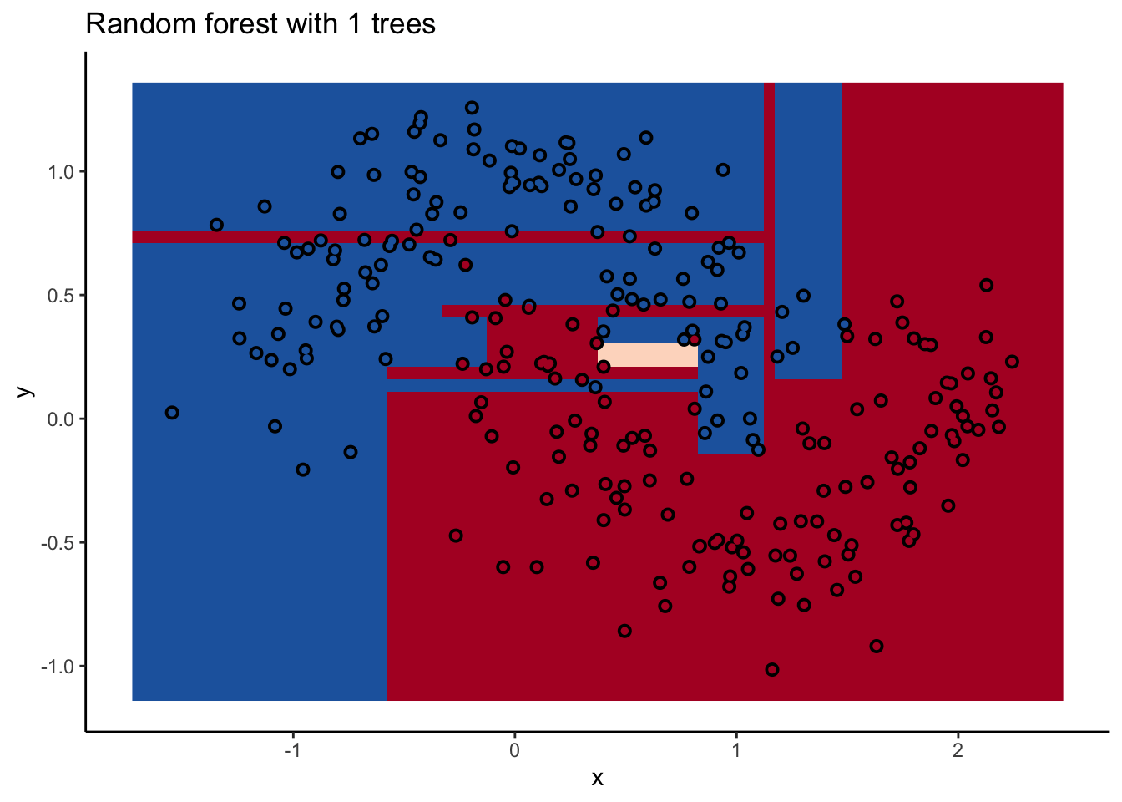
Random Forests

Slide 14
Boosting METHODS

Slide 15
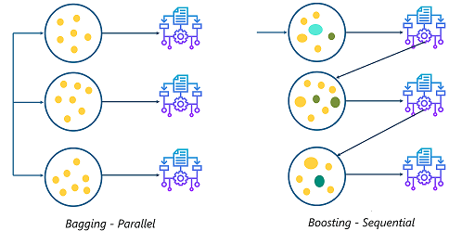
Boosting Methods
Boosting methods combine “weak” learners to create a single strong learner
Weak learners are models that are only slightly better than random guessing
The strong learner is usually created by adding weighted weak learners together and reweighting data to prioritize incorrectly labeled samples (or regression errors) as the process continues
Boosting methods are ensemble methods (similar to random forests etc.) that prioritize misclassified data and perform sequential error minimization
Figure 7. Bagging vs. boosting

Slide 16
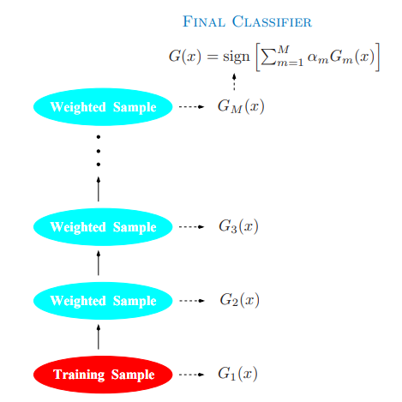
Adaboost
Adaboost (Adaptive Boosting) is one of the most popular boosting algorithms
It starts by assigning the same weights to each sample and fitting a learner to the samples
The samples are then reweighted according to the error of the prediction of the model. More weight is given to samples with higher prediction error and to models with better predictive ability
As the process continues, new models are specialized for classifying a few
hard-to-classify samples and thus have less say on the overall classification model
Figure 8. Adaboost

Slide 17
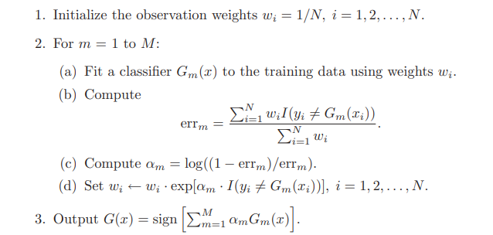
Adaboost
The Adaboost algorithm. Note that the error for a weak learner should always be less than 0.5 (classifying to the majority class)

Slide 18
Gradient Boosting
Fit a weak learner to the data
Sequentially fit and add models that result in the largest improvement to a loss function (using gradients)
Continue until a stopping rule applies
Different types of loss function (as long as they are differentiable) can be minimized for classification tasks
using gradient descent
Shrinkage parameter (ranges from 0 to 1) multiplies the new model by a scalar to avoid overfitting
Specific parameters for gradient boosted trees (depth of trees, number of trees etc.)
Stochastic gradient descent (SGD) samples a fraction of the data to converge faster while avoiding local minima

Slide 19
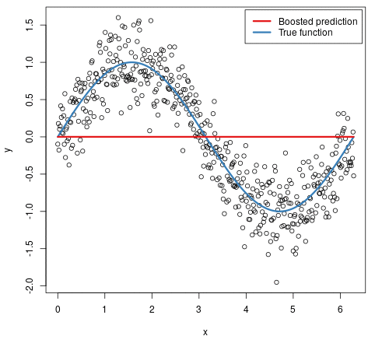
Gradient Boosting
Figure 9. Gradient boosted regression tree. Trees are sequentially added together to make a more accurate model

Slide 20
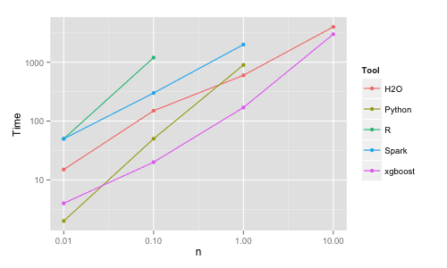
XGBoost
XGBoost (eXtreme Gradient Boosting) is a gradient-boosted decision tree machine learning library
Computationally efficient. Works great for structured tabular data
*XGBoost uses the newton’s method instead of the regular descent algorithm and uses various measures to regularize the tree (L1 and L2 norms). See What makes “XGBoost” so Extreme?. A comprehensive guide to the inner… | by Eoghan Keany | Analytics Vidhya | Medium for more information
Figure 10. Benchmark performance of xgboost

